Slide 1

Sprocket Central Pty Ltd
Unnati Singh
Date- 27 May 2023

Slide 2
Agenda
Introduction
Data Exploration
Model Development
Interpretation

Slide 3
Introduction
Sprocket Central Pty Ltd
Sprocket Central Pty Ltd specializes in high-quality bikes and accessible cycling accessories for riders.
Their marketing team is looking to boost business by analyzing their existing customer dataset to determine customer trends and behavior.
They have given us the Datasets that contain the information about their orders and their customers.
Sprocket Central Pty Ltd has provided us 4 datasets
1. Transactions data
2. Customer Demographic
3. New customer list
4. Customer address
Our Aim
We aim to know about useful customer insights which could help the company to improve performance by focusing on high-value customers.
Steps –
Data cleaning Data Transformation Data Exploration

Slide 4
Data Exploration
Brand and Style
Insights-
Customers are more likely to buy Solex brand among the other brands.
Standard product are most buyable products by customers among the other

Slide 5
Data Exploration
Total Sales based on months
Insights-
November, August, July, and January have the maximum sales.

Slide 6
Data Exploration
Industry and Gender vs. Sales
Insights-
Women followed by men working in Manufacturing, Finance services, and Health sectors are more likely to buy the product.

Slide 7
Data Exploration
Type of customer vs. Sales
Insights-
More than half of the sales are of mass customer.

Slide 8
Data Exploration
State vs. Sales
Insights-
People living in NSW (New South Wales) are more likely to buy the products.

Slide 9
Data Exploration
Age Group vs. Sales
Insights-
People from the Age group of (40-49) yrs. are more likely to buy the product followed by the age group of (50-59)yrs.

Slide 10
Model Development
The marketing team Should focus on the following points to increase sales
Solex brand and Standard product as the top priority.
Should focus more on November, august and July months.
People in Manufacturing, Finance services, and Health sectors
Female customers
Customers in the Mass Consumer Segment.
Customers living in New South Wales
Age group (40-49)yrs.

Slide 11
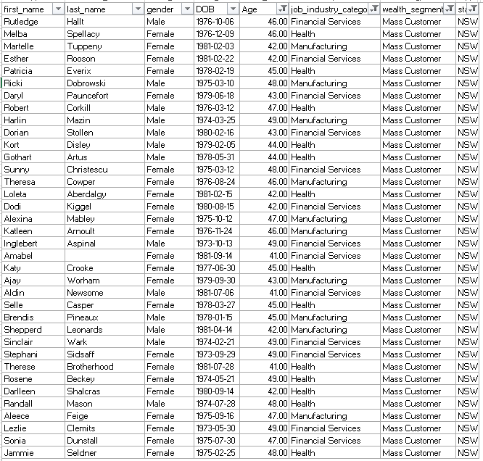
Interpretation
After filtering, here is the list of the customers that should be targeted-

Slide 12
Appendix

Slide 13
Appendix
Thank you

